Slide 1
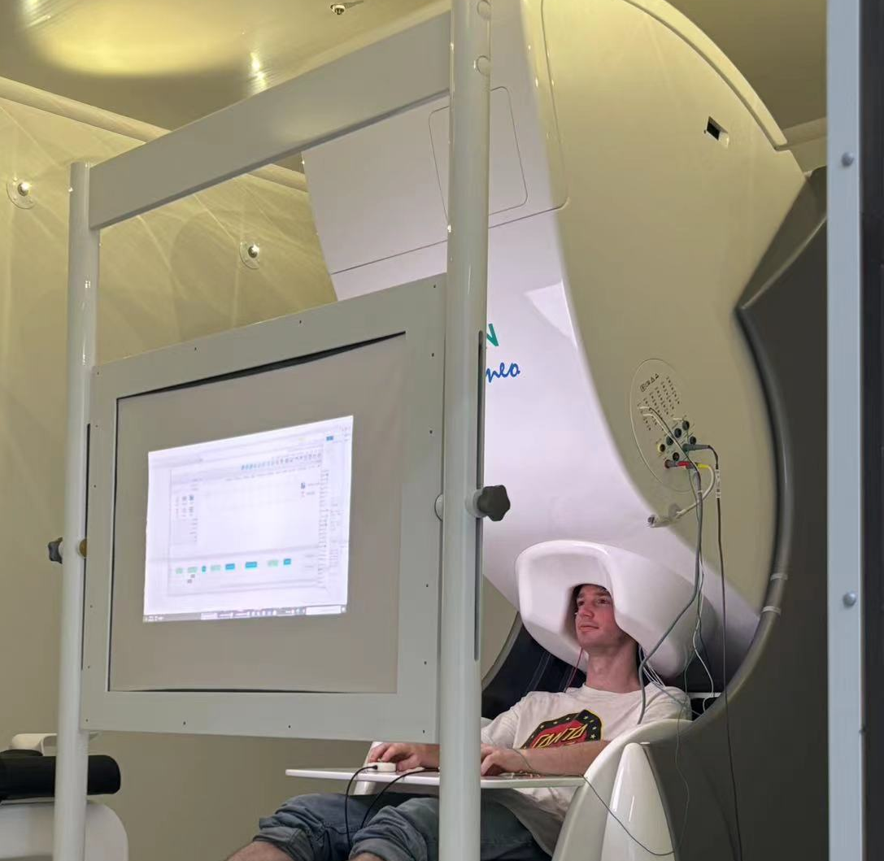
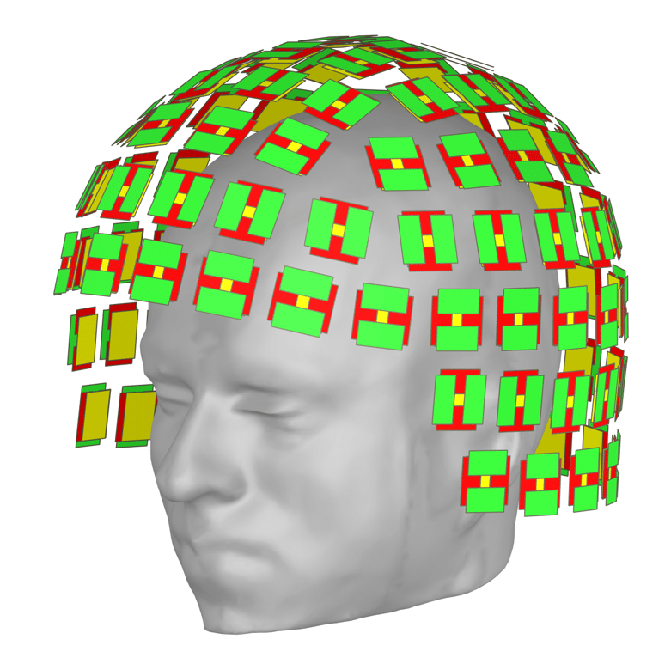
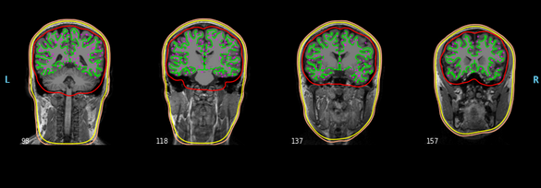
Decoding multiple attributions of visual stimulus from MEG signals
Mu Yangjiayi, Qiuhao Yin, Mark Forbush, Chun Yin Mou

Slide 2
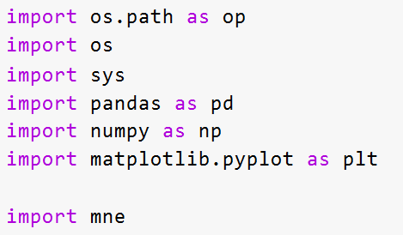


MNE Toolkit
Toolkit for analysis and visualization of MEG and EEG data
Includes tools for source estimation (projection onto brain surface, volume) and visualization
Machine learning tools (SVM, ICA) for classification and denoising
Matlab backend with Python integration aids in the ability to verify results and produce new research in a streamlined fashion
Large support group keeps keeps these tools up to date with current research

Slide 3
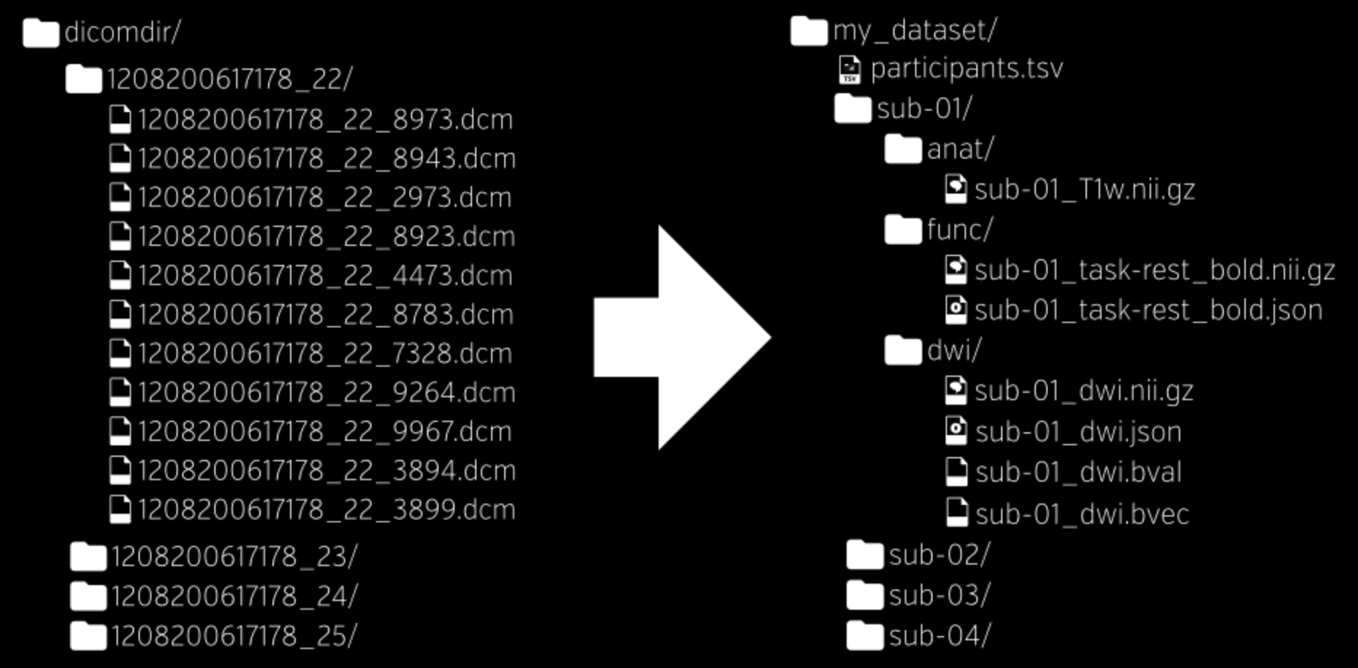
MNE-BIDS format
Introduction to MEG BIDS:
MNE BIDS (Magnetoencephalography Brain Imaging Data Structure) is designed to standardize the format for organizing and sharing MEG data.
Ensures data is organized consistently, facilitating reproducibility and accessibility of MEG studies.
Notes:
MEG BIDS is a standardized format for organizing and sharing MEG data, designed to ensure consistency and reproducibility in MEG studies. Neuroimaging experiments produce complex data that can be organized in various ways. Previously, there was no consensus on how to organize and share this data, even among researchers in the same lab, leading to misunderstandings and wasted time on rearranging data or rewriting scripts. The Brain Imaging Data Structure, or BIDS, describes a simple and easy-to-adopt method for organizing neuroimaging and behavioral data.
BIDS was heavily inspired by the format used by the OpenfMRI repository, now known as OpenNeuro. During its development, many neuroscientists were consulted to ensure it covers most common experiments while remaining intuitive and easy to adopt. The specification is based on simple file formats and folder structures, reflecting current lab practices and making it accessible to a wide range of scientists from different backgrounds.

Slide 4
MNE-BIDS format
Data Acquisition:
MEG Systems:
306-sensor TRIUX MEGIN system, with 204 planar gradiometers and 102 magnetometers arranged in a helmet-shaped array.
Recording Setup:
MEG gantry positioned at 68 degrees for optimal coverage of frontal and posterior brain areas.
Simultaneous EEG recorded using an integrated EEG system with a 64-channel electrode cap.
Data Collection:
MEG and EEG data bandpass filtered (0.01-330 Hz) and sampled at 1000 Hz.
Head fiducials, head shape, EEG electrode positions, and head position indicator (HPI) coil locations digitized using a 3-D digitizer system.
ECG recorded with bipolar electrodes on the chest; EOG recorded with electrodes around the eyes.
Ground and reference electrodes placed on the back of the neck and right cheek, respectively.
Head position measured at the beginning and end of each run, and before and after each resting period
Notes:
For data acquisition of the dataset we’re using, they utilize a 306-sensor TRIUX MEGIN system, which includes 204 planar gradiometers and 102 magnetometers arranged in a helmet-shaped array. The MEG gantry is positioned at 68 degrees to provide optimal coverage of frontal and posterior brain areas. Simultaneous EEG recordings are made using an integrated EEG system with a 64-channel electrode cap, though the EEG data is not reported here. During acquisition, both MEG and EEG data are bandpass filtered between 0.01 and 330 Hertz and sampled at a rate of 1000 Hz.
Additionally, ECG data is recorded using bipolar electrodes placed on the subject’s chest, while EOG data is captured with electrodes positioned around the eyes. Ground and reference electrodes are placed on the back of the neck and on the right cheek, respectively. The subjects’ head positions are measured at the beginning and end of each run, and also before and after each resting period using four HPI coils placed on the EEG cap, next to the left and right mastoids, and over the left and right frontal areas

Slide 5


Flux Pipeline
Based on MNE-BIDS in conjunction with jupyter notebook to further streamline research and create a dedicated framework for analyzing MEG and MRI data
Includes example datasets and tools for data acquisition in order to further new neurological research
Step-by-step instructions
Focuses heavily on the denoising process to create robust standards for the analysis of behaviour neurological data (one problem in the field today)
Additionally includes tools for source localization and analysis of neuronal oscillation (alpha, beta, gamma, etc) in order to better analyze patterns in brain activity
Purpose: Standardized MEG data analysis framework for cognitive neuroscience.
Components: Uses MNE Python and FieldTrip toolboxes with Jupyter notebooks and MATLAB Live scripts.
Applications: Focus on neuronal oscillations and source localization in cognitive tasks.
Data and Tools: Includes example datasets and step-by-step instructions.
Evolution: Continuously updated for the latest MEG advancements.

Slide 6

Arc Cogitate
Theories Tested: Global Neuronal Workspace Theory (GNWT) vs. Integrated Information Theory (IIT).
IIT : consciousness arises from the ability of system to integrate information
GNWT : consciousness arises from information in specific areas of the brain and the interconnectedness of those parts
Both theories are possible but it’s likely one describes consciousness more accurately
Key difference : IIT postulates that conscious states will tend to correspond to states of high interconnectivity, GNWT postulates that consciousness will correspond to specific activation of certain regions in the brain, not necessarily through all information being directly correlated
Methods: Uses fMRI, M-EEG, and iEEG data from 500 participants.
Adversarial Collaboration: Rigorous approach testing contradictory predictions of both theories.
Goal: Provide decisive evidence favoring one theory, advancing consciousness research.
Open Source : Data and findings will be openly shared to support further discoveries.
Notes:
Project ARC Cogitate: Large-scale research initiative on consciousness.
GNWT: Focuses on global information broadcasting by a fronto-parietal network.
IIT: Focuses on intrinsic information integration within specific brain regions.
GNWT: Consciousness arises from large-scale brain communication.
IIT: Consciousness arises from local integrated information.

Slide 7
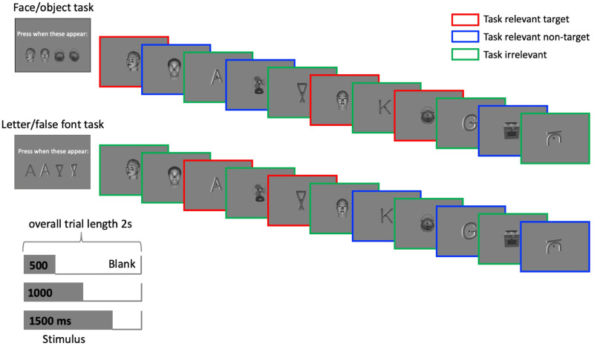
Our Dataset (subset of arc cogitate data CB069)
Dataset Overview:
Our dataset is a subset of the ARC Cogitate data, comprising MEG recordings from X participants.
The data was collected using the 306-sensor TRIUX MEGIN system.
Each recording session lasted Y minutes and involved tasks such as [brief task description].
Notes:
Our dataset is a subset of the ARC Cogitate data and includes MEG recordings from X participants. These recordings were made using the 306-sensor TRIUX MEGIN system. Each recording session lasted approximately Y minutes and involved tasks such as [task description].

Slide 8
Our Dataset (subset of arc cogitate data)
Data Characteristics:
Raw MEG signals, preprocessed data, and metadata.
Organized in BIDS format for reproducibility and accessibility.
Each participant’s data includes 102 magnetometers and 204 planar gradiometers.
Preprocessing:
Converted to BIDS using MNE-BIDS, preprocessed with FLUX pipeline in MNE-Python.
Includes MEG sensor reconstruction and Signal-Space Separation (SSS) to reduce artifacts.
FastICA used to remove cardiac and ocular components.
Data segmented, with muscle artifact segments removed before ICA.
Epoched into 600ms segments (100ms pre-stimulus to 400ms post-stimulus).
Trials exceeding 5000 fT/cm for gradiometers or 5000 fT for magnetometers, or containing muscle artifacts, were rejected.
Notes:
The dataset includes raw MEG signals, preprocessed data, and comprehensive metadata, all organized in the BIDS format to ensure reproducibility and accessibility for future research. Each participant’s data includes recordings from 102 magnetometers and 204 planar gradiometers, providing a rich dataset for analysis.
Preprocessing of the data involved converting it to BIDS using MNE-BIDS and then processing it through the FLUX pipeline in MNE-Python. This process included MEG sensor reconstruction using a semi-automatic detection algorithm and Signal-Space Separation (SSS) to reduce environmental artifacts. We used FastICA to detect and remove cardiac and ocular components from the data for each subject, with an average of 2.90 components removed per subject.
Prior to ICA, the data was segmented, and segments containing muscle artifacts were removed. After preprocessing, the data was epoched into 3.5-second segments, ranging from 1 second pre-stimulus to 2.5 seconds post-stimulus onset. Trials where gradiometer values exceeded 5000 fT/cm, magnetometer values exceeded 5000 fT, or that contained muscle artifacts were rejected from the dataset. This preprocessing ensures that the data is clean and suitable for further analysis.

Slide 9
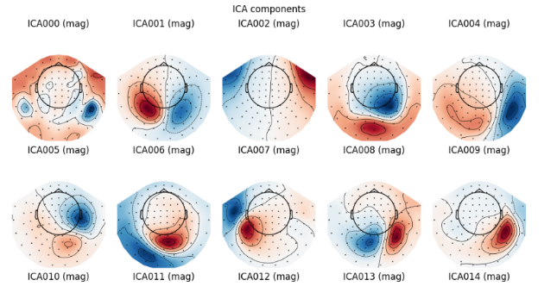
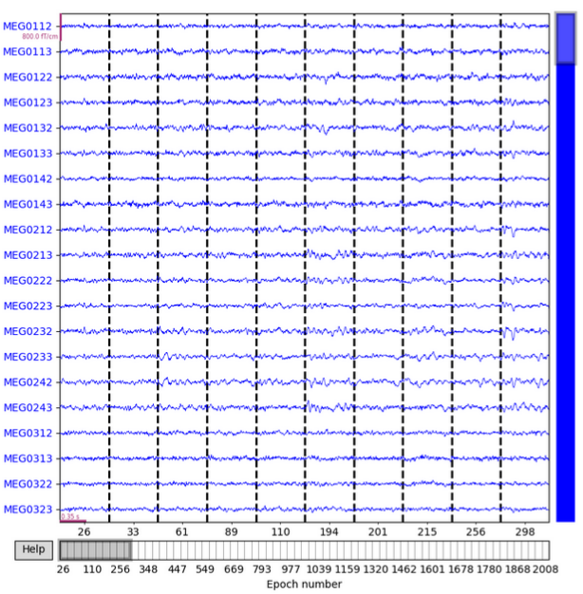
Specific Methods Implementations
Maxwell filtering (SSS) using our physical understand of the MEG sensors to denoise the data
Independent Component Analysis (ICA) for removal of specific regions we believe to associated with unnecessary information (heartbeat, blinking, muscle twitching, etc)
Partitioning MEG into time windows around specific stimulation (epochs)

Slide 10
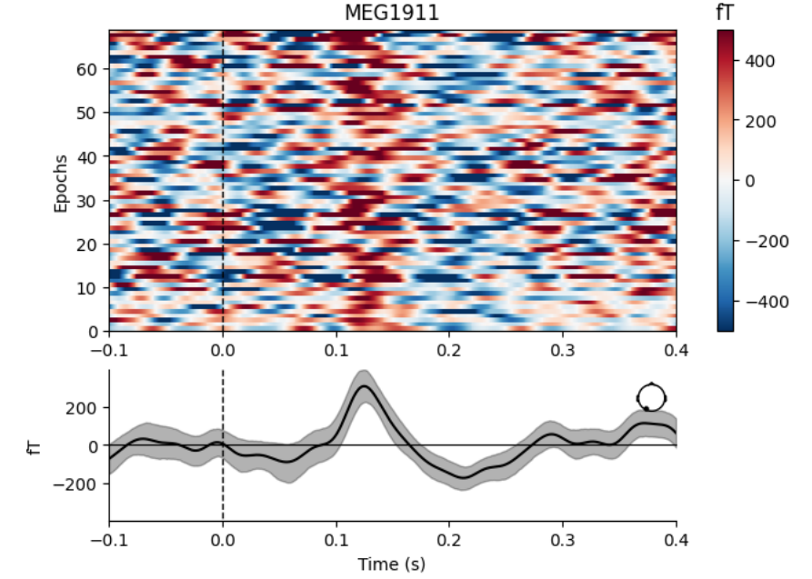
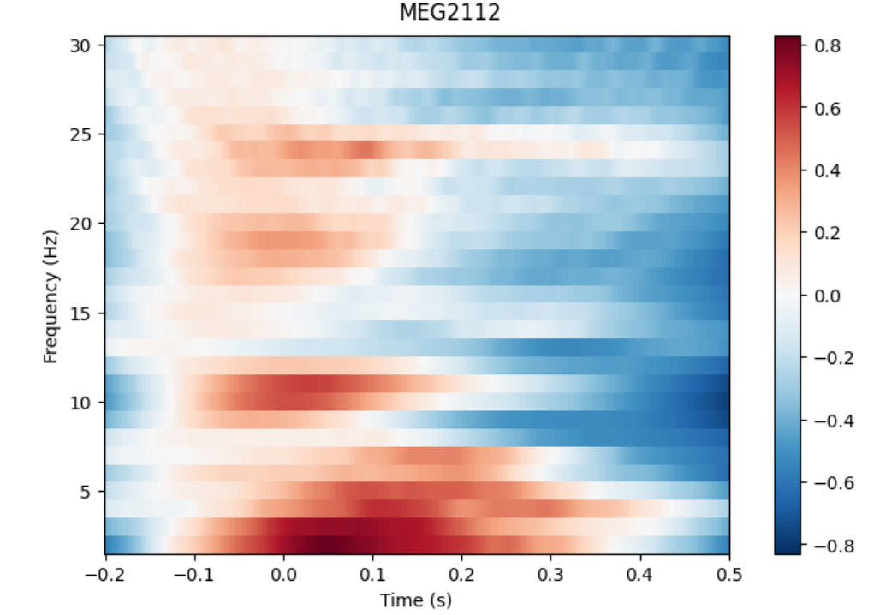
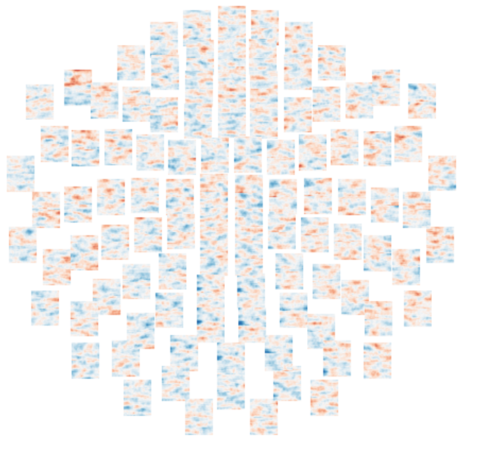
Event Related Fields (ERFs)
ERFs are field responses, measured using MEG, over time to specific stimuli
Fourier decomposition of ERFs allow us to analyze particular bands and relate that to past research

Slide 11
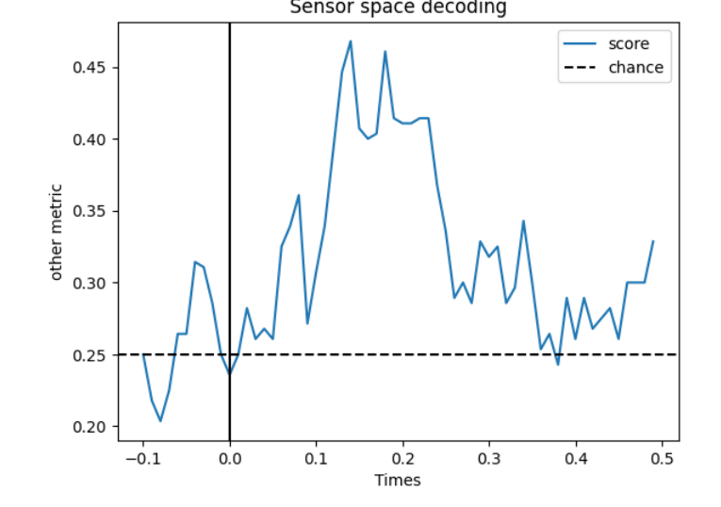
Classification of ERFs
Our linear classifier (multiclass-SVM) is able to distinguish brain states in response to specific stimuli (face, object, letter, or false letter) significantly better than random chance. Indicating distinct activation for different objects
Specifically shows which times the classifier is able to distinguish each stimuli from the brain state

Slide 12
Conclusion
Visual analysis of ERFs show distinct activity in response to stimuli, indicating good data collection
Multivariate classification is able to distinguish specific stimuli from brain activity at specific times, indicating distinct activation for each class (face, object, letter, etc)
Time series classification tends to have most significant results around 100ms after stimuli (visually appearing like a normal distribution around that point)
Classification tends to perform worst (about in line with random chance) 100-200 ms before stimuli, indicating baseline activity
More work is necessary to see which classes are most distinct and if that carries across a larger set of subjects

Slide 13
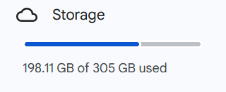
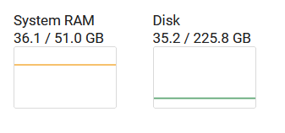
Discussion and Future Work
Due to time constraints and limitations in computational resources, more work should be done to expand these results in a more general way
Comparisons across more runs may require much larger systems than we have access to at the moment
Visualization of activity on the volume or surface of the brain from MEG data (inverse model)
More advanced methods for clustering and classification (linear and non-linear projection, neural nets, auto-encoders, etc) could be implemented to understand differences in brain activity in response to stimuli

Slide 14
Specific Acknowledgements
Mu Yangjiayi our advisor (help with understanding and implementation of various tools used in this project)
NIH, NSF, MNE, and Flux pipeline teams (for the production of these toolkits)
Fudan University (for the sponsorship and funding of this program)

